Slide 1
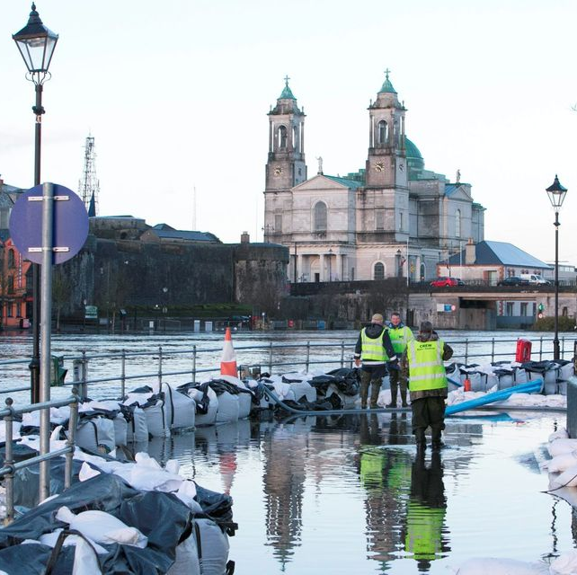
High Capacity Pump Project
Alan O Neill
Chief Fire Officer
Westmeath Fire & Rescue Service

Slide 2
Flooding
River Flooding
Heavy Rain & Run Off
Surface Water Flooding
Heavy Rain Fall Over Short Time Periods
Groundwater Flooding
Ground at Saturation Point
Marine Flooding
High Tides, Storms, Coastal Defences
Sewer Flooding
Heavy Rain & Blockages
Burst Water Mains
Localized Flooding of Critical Infrastructure
Dams & Reservoirs
Structural Failure & Blockages

Slide 3
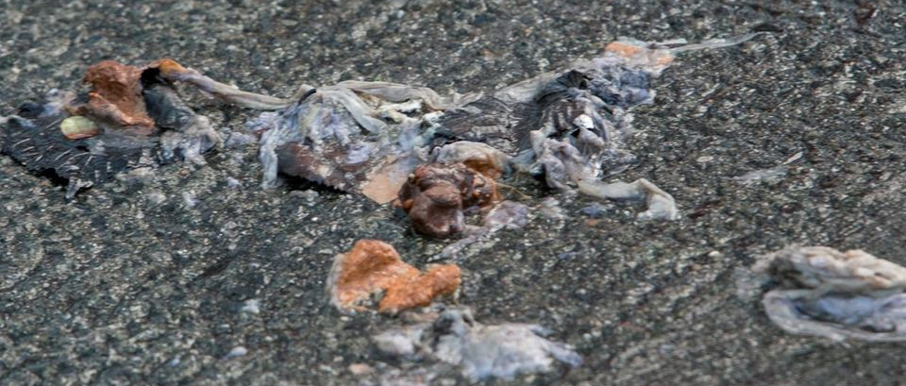
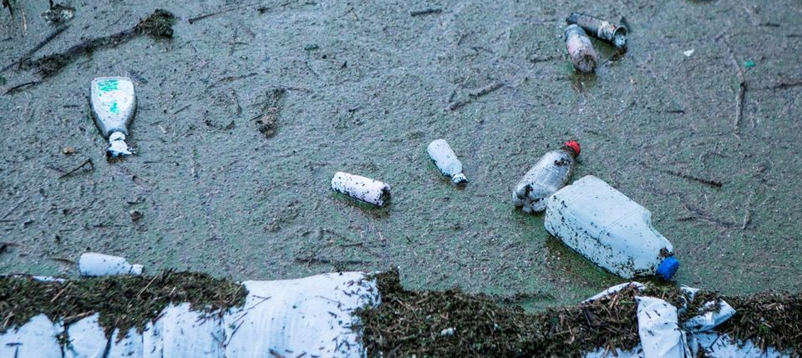
Thousands of litres of raw sewage pour onto the streets of Athlone as locals battle filthy flood waters

Slide 4
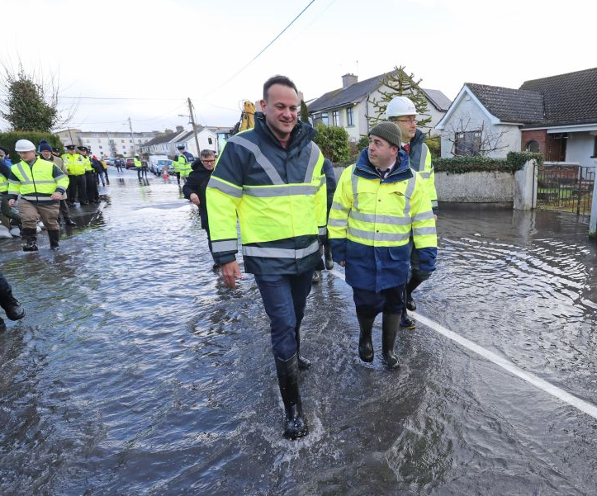
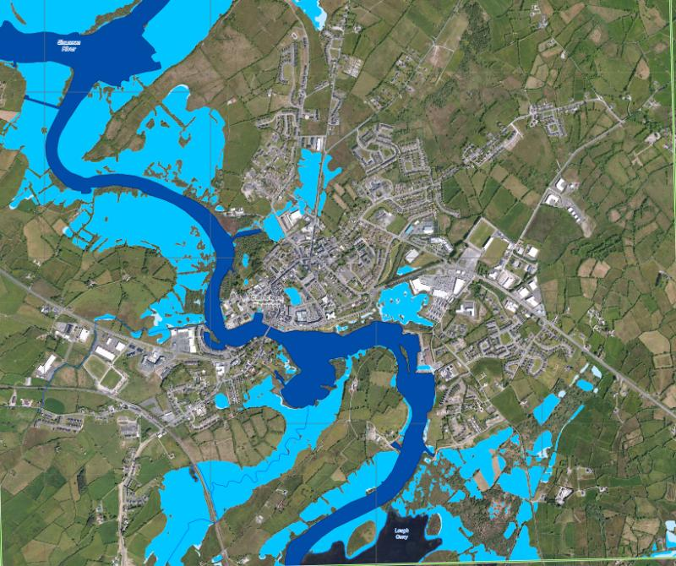
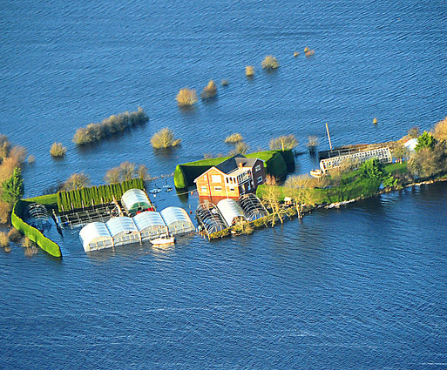
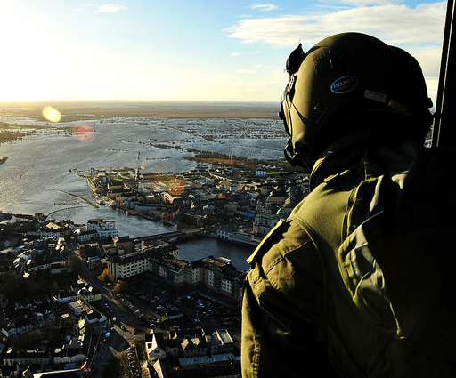

Slide 5
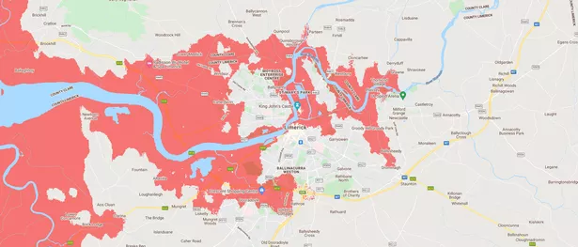
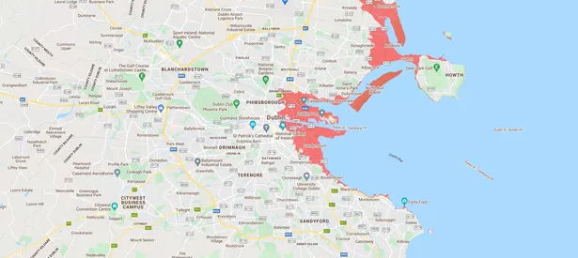
2030 – Flood Prediction Maps Limerick & Dublin

Slide 6
South East – 2030 Prediction

Slide 7
National Project – High Capacity Pumping
EU Civil Protection Mechanism
The protection of people, the environment and property against all kinds of natural and human-induced disasters – Involves Planning & Preparation
Identified a Requirement for Flood Response IRL – Emergency Planning Framework
The primary use anticipated is protection of Critical Infrastructure, Flood events, forest/Wildland fires for protracted industrial fires.
Funding Available
National Working Group
NDFEM
OPW
Local Authority – Cork, Dublin, Galway & Westmeath
GAP Analysis
Propose a Solution

Slide 8
Hytrans Fire Systems
https://www.youtube.com/watch?v=-6NXWmufEOQ

Slide 9
High Capacity (Volume) Pumps
Can be used to transfer large volumes of water, long distances over short time periods (Typically 7/9,000L/Min)
Move Flood Water
Pre-Emptively Mitigate Flooding at incidents (embankment failure)
Provision of Firefighting water
Risk of over abstracting
Biosecurity Risk (Infection, Animal & Plant Disease)

Slide 11
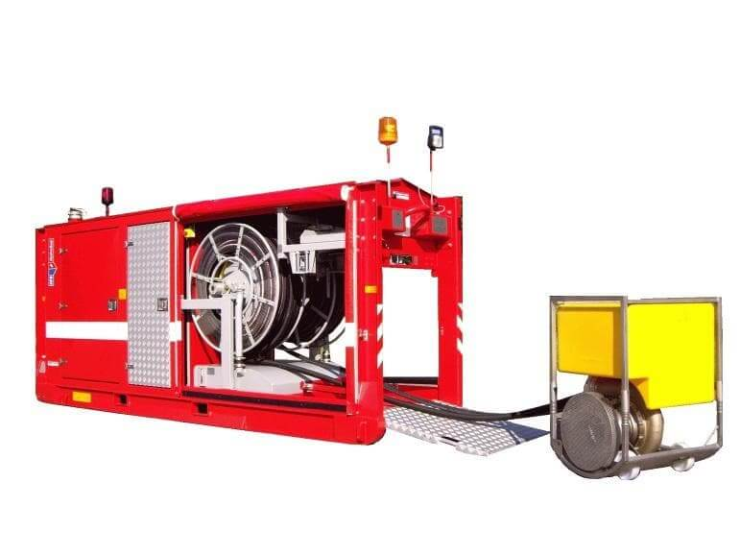
High – Capacity Pumping Units
Consists of 2 demountable modules (Pump, Hoses & Ancillaries)
Pump
Hydrosub – A Large Diesel Unit (3 Ton) carried on a prime mover & deployed by use of a Hook Loader & Winching System.
Submersible Pump Unit (Similar to a portable pump) deployed into water
60M of Hydraulic Hose
6”/12” (150/300mm) Lay-flat (Stortz) Hose
Centrifugal Pump

Slide 12
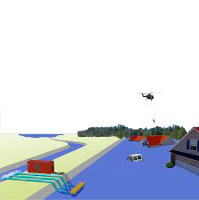
HCP For Flooding
How Safe is your Area?
Are there any Flood Risks or Dangers to Critical Infrastructure?
Could you cope with a large flooding event?
Water is a powerful force and can be overcome by use of Hydraulically driven mobile pumping systems which can drain water away in relatively short time frames
Pumps have output capacities of between 1,500 – 20,000L/Min (HydroSub 60) & 3,500 – 50,000L/Min (HydroSub 150)

Slide 13
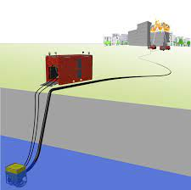
HCP For Fires
Large Urban Fires
Rural/Farm Fires
Wildland, Forest or Bog Fires
Refuse – Landfill, Recycling & Transfer Centers
Cooling Battery Energy Storage Systems
Water often Available but not accessible
Hydraulically Driven Submergible Portable Pumps can provide fast access to open water several Kilometers from an incident using Hydraulic Pressure and High Volume Hoses with little friction loss.

Slide 14
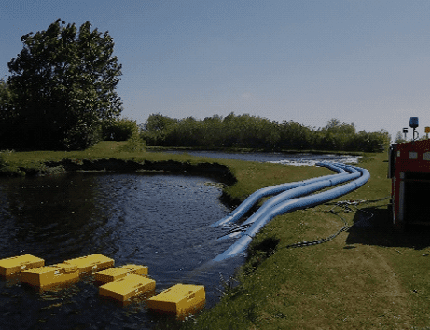
Components of HCP System
Submersible Hydraulic Pump
Diesel Engine Main Pump
60M Hydraulic Hose Reel
150/300 mm Φ Lay Flat Hose (10M Lengths – Stortz Connections)
Hose Layer/Retrieval Unit (Hydraulic) 40Km/Hr
2 Prime Movers
Ancillaries – Monitors, Hose Ramps, Keys, Etc.
Typical Make Down of 3Km is approximately 20 – 30 Minutes

Slide 15
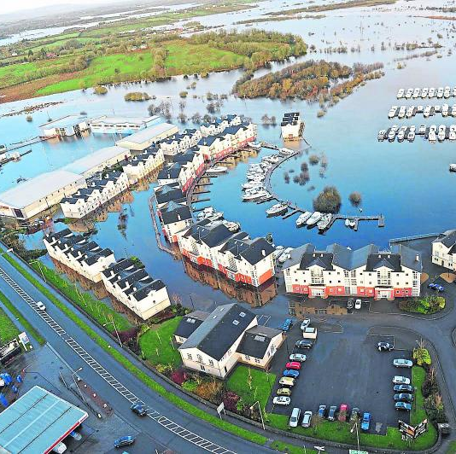
Gap Analysis
What resources are currently available nationally to deal with flooding and moving large volumes of water?
Office of Public Works (OPW)
Local Authority
Fire Services

Slide 16
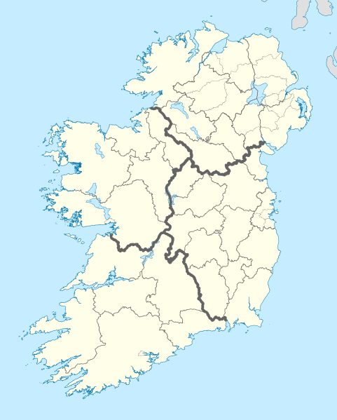
Current Locations – OPW
2
1
Mayo (1)
Galway (2)
Donegal (2)
Westmeath (2)
Limerick (4)
Meath (6)
Wexford (2)
Total (19)
2
6
2
4
2

Slide 17
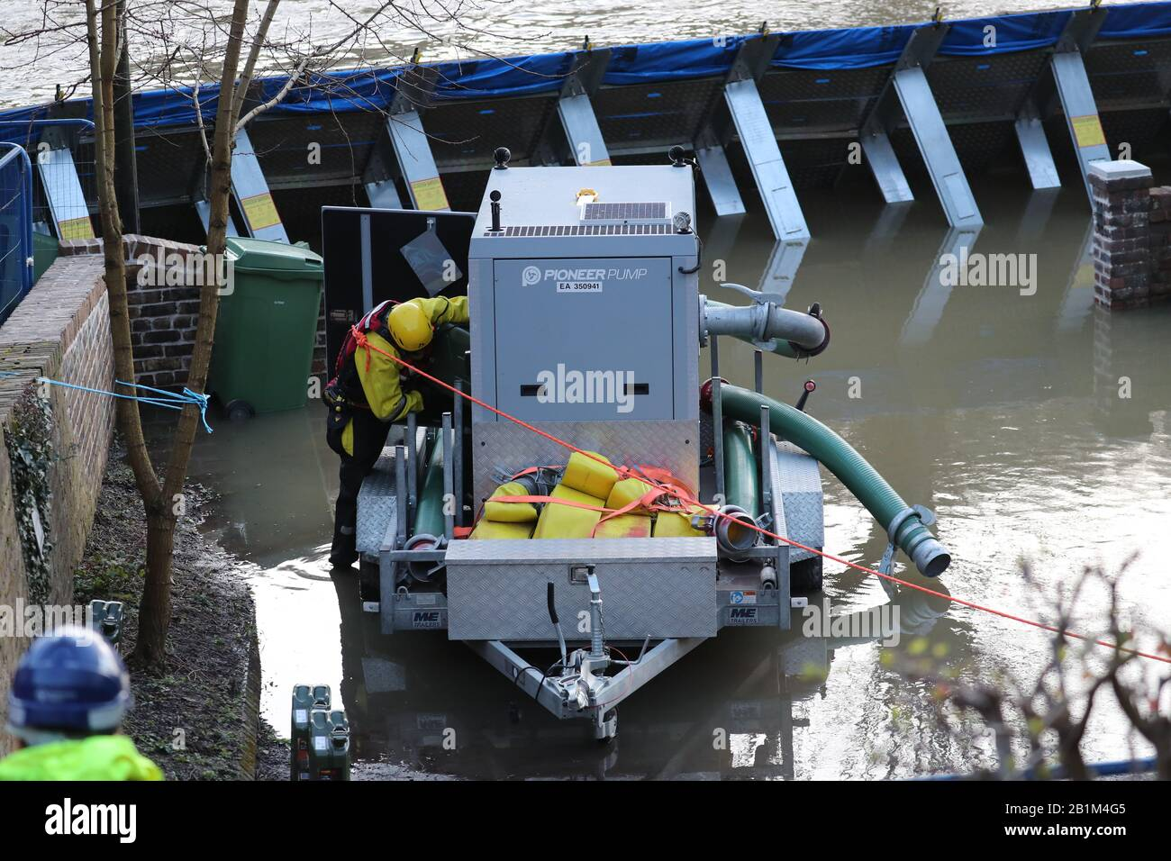
OPW – Conditions of Use
Local Authority Responsible for the Pump, Health & Safety – Risk Assessment
LA – Responsible for Damage and Must be Insured for Use
Must Provide Induction Training for OPW staff
Lifting Plan Must be in Place – SWL, GA1 Certificates and trained persons
Operators must be trained prior to use
Only use as directed by OPW
Safe & secure storage
Only use for Flood Relief
1st Come 1st Served System

Slide 18
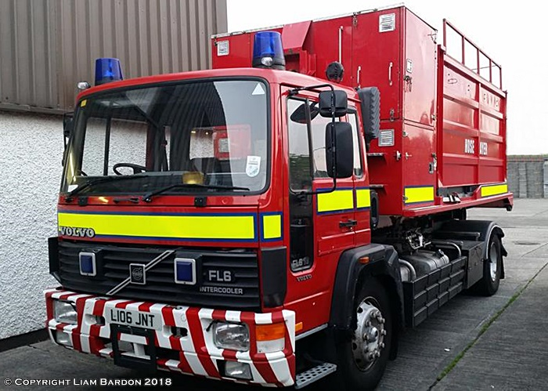
Fire Service Locations
Cork, Dublin & Westmeath
Hydrosub 150
Hose Retrieval Unit
2 Prime Movers
Hose
Ancillary Equipment (Hose Ramps, Tools Monitors, etc.
Circa. 20+ Years Old
Local use mainly

Slide 19
Proposal
?
1
Consider locations with Historical Flood Data – Initial proposals
Cork, Dublin, Galway, Westmeath, Donegal (Under Consideration)
Act As Regional Resources for Flood & Fire
Aligned with UK & European systems
Interoperable with NI FRS system
Appoint a Contracting Authority to lead Procurement
SLA Required for Deployment
Training
1
1
1

Slide 20
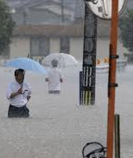
Summary
Requirement to have a National Response to a Flood Emergency
Project Team Established
Gap Analysis Concluded
Support Flood & Fire Emergencies
Aligned with European & UK Systems
Interoperable
Regionally Based – 4 or 5 Locations Initially
Equipment List Generated
Recommendation to the Board of Management

Slide 21
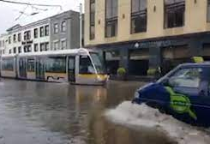
Thank You For Your Attention
Questions & Comments

