Slide 1
Technical Seminar
Date: 19TH October 2023
Location: Tullamore , Co. Offaly

Slide 2
Thank you for the Opportunity to speak at today's Seminar Brigid Walsh C Eng : Project Director Colin Kiely: Electrical Lead

Slide 3
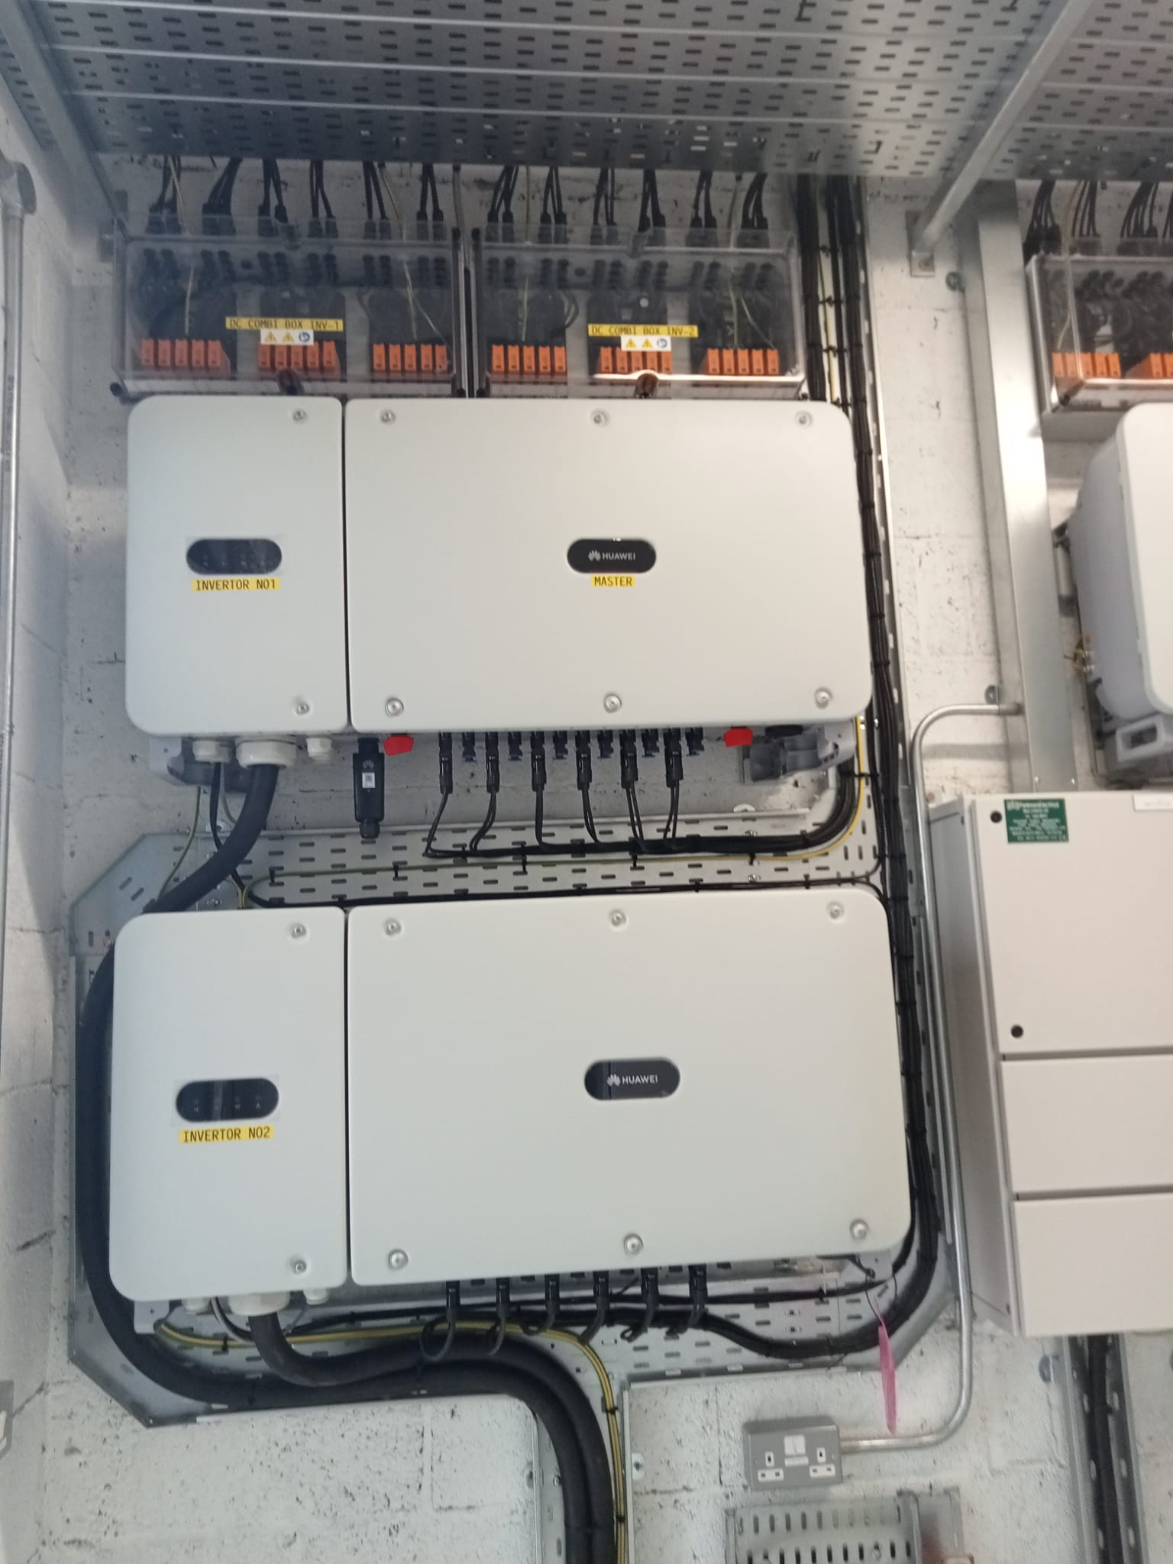
Solar PV
Solar PV System Design
Solar PV Components
Solar PV Operation

Slide 4
Designing Solar PV Plant
Design Decisions /Product Data Sheets/ Spec all in accordance with NSAI/RECI/ Part L /SEAI/Home Bond
KVA – Building ( single or triple phase )
Roof Type & Access
Cable Runs /Cable Type
Panel size /type and Certifications
Inverter size /type and Certifications
Battery size /type and Certifications
AC /DC isolators size /type and Certifications
Shunt /Fireman's switch size /type and Certifications
Combiner Box – Fireman's switch – Surge 1 & Lightning Protection size /type and Certifications

Slide 5
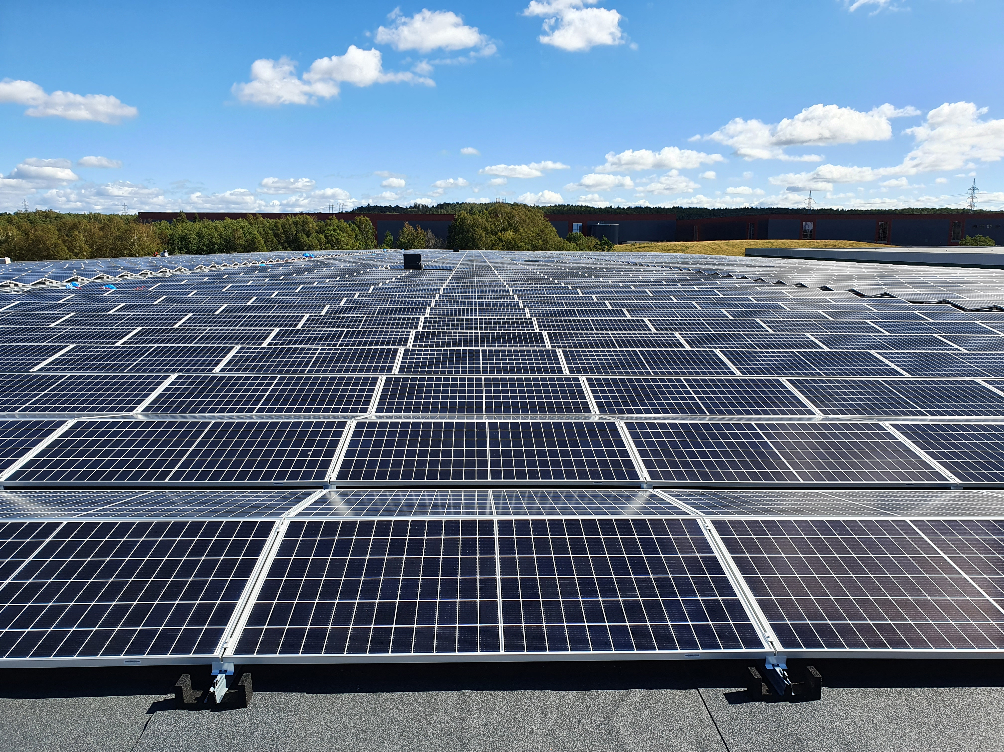
ESB Categories Ref ; NSAI Irish Standard I.S. 10101:2020 Part 712 page 578 to 592

Slide 6
DOMESTIC SCHEMATIC

Slide 7
Design – inverter choice

Slide 8
design – battery choice

Slide 9
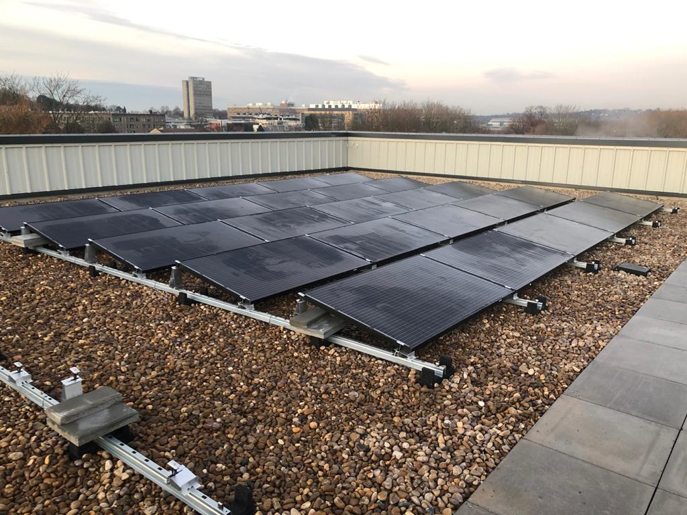
Solar pv design
Specifications ; Industry Standards & shared knowledge ; Feedback
PV Panel :
Cable DC/AC/Earth etc :
DC/AC Isolators :
Fireman's Switch /shunt:
In house /External training keeping up to date

Slide 10
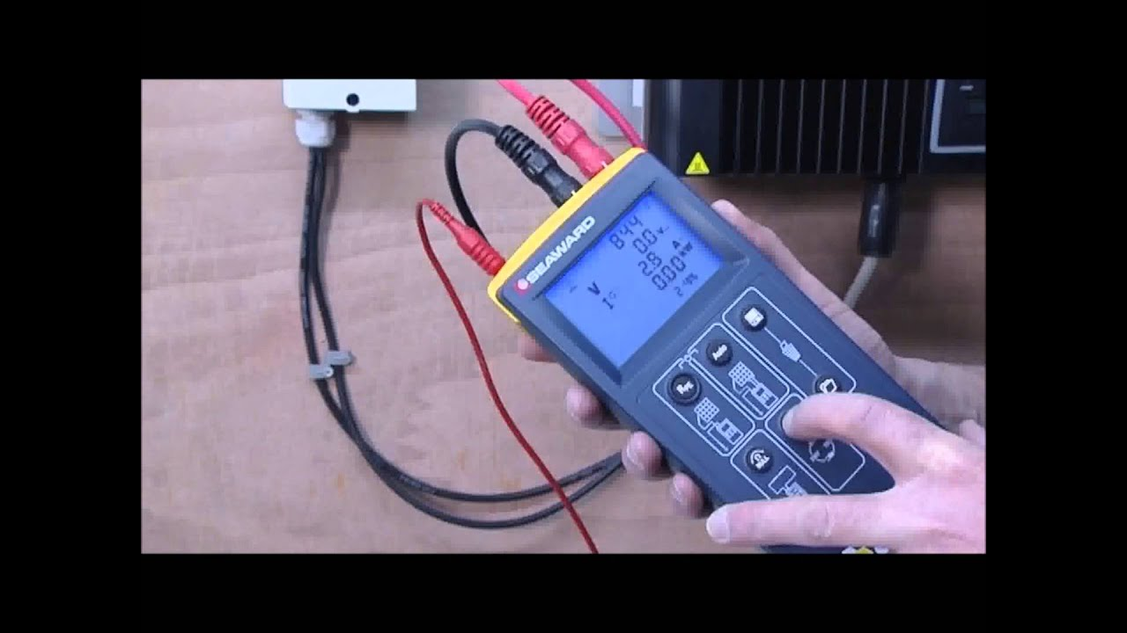
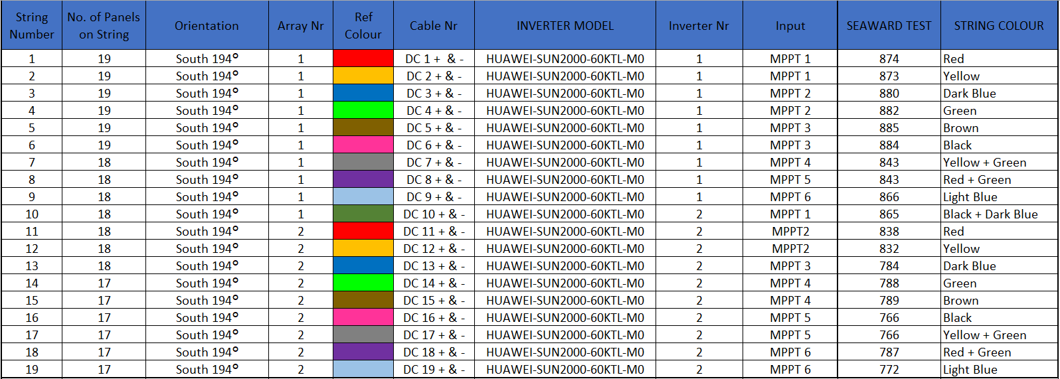
Testing Panel & String Testing
SEAWARD PV200 SOLAR PV TESTER & I-V Curve Tracer (389A910)

Slide 11
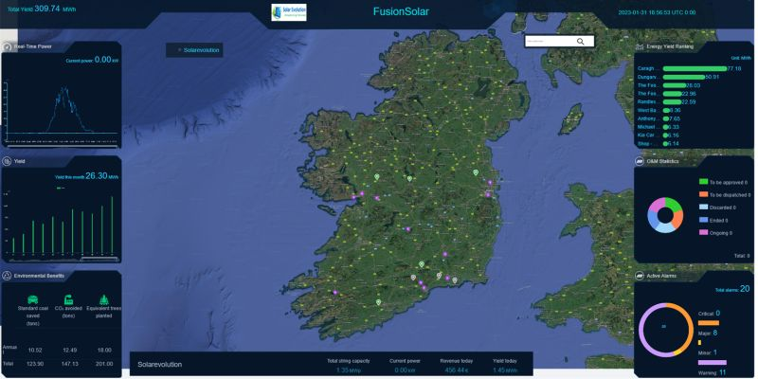

Slide 12
Smart Technology
Add on to documents prepared during installation
Setup a central - Database for each Eircode ( Home or Business)
In House - Training to go through a solar PV installation (understanding components and their function and capabilities ) Sharing knowledge and experience gained in the field.
QR Code outside building
Placard outside Building
Indicating to Firefighters that a solar/battery/type of Inverter ( string or microinverter) has been installed and Where the systems and shutoffs are located.
Suggest Add on to SOPS already in place

Slide 13
Solar pv products
disposing of end of life / faulty /damaged solar pv products
All products purchased by solar evolution are weee compliant
returned to suppliers for recycling in the correct manner .

Slide 14
Thank you
Presenter names:
BRIGID walsh & COLIN Kiely
Email address: Brigid.walsh@solarevolution.ie
Website ; www.solarevolution.ie

